Slide 1

Amazon Product Review Analysis
Exploring Customer Sentiments and Data Analysis
By :
Abishek. V
Deepak Rana
Gokul. P

Slide 2
INTRODUCTION
1. Amazon, which started as a small online retailer in 1994, has become the world's largest online shopping platform with over 150.6 million active users.
2. In today's digital era, product reviews hold a key significance for businesses. With the increasing prominence of social media and online review platforms, monitoring and analysing them have become even more important.
3. Positive reviews play a significant role in 57% of Amazon buyer's purchasing decisions. The manual process of analysing product reviews can be inefficient and time-consuming.
4. Therefore, Dynamic review analysis is necessary for businesses to monitor customer feedback and improve their products and services.

Slide 3
OBJECTIVE OF ANALYSIS
1. Enhancing business understanding and improving its performance by analyzing customer reactions and sentiments.
2. Identifying top-rated products and top customers from customers reviews.
3. Clustering the customers and extracting the key characteristics of customer behaviors.
4. Developing a machine learning algorithm for classifying customer sentiments in new product reviews.
5. Forecasting future customer sentiment trends by analyzing reviews.
6. Upon thorough analysis of the results, we have formulated recommendations and derived conclusions.

Slide 4
DATA OVERVIEW
1. The Amazon dataset covers customer reviews from May 1996 to July 2014 for various products.
2. The dataset used for the research was specifically for grocery and home and kitchen from the website Amazon Product Reviews.
3. The dataset includes product categories, customer ratings, and written reviews on Amazon, and is available for research purposes.
4. The data is publicly available and was collected by Julian McAuley and his team at the University of California in San Diego.
5. The dataset has 12 features and 100,000 observations, offering broad customer sentiment analysis for grocery, gourmet, and home and kitchen products.

Slide 5
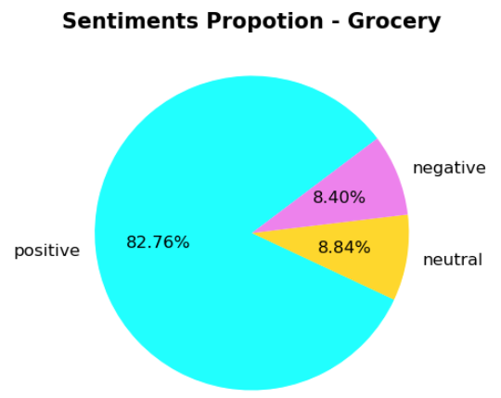
SENTIMENT ANALYSIS-GROCERY
1. The sentiment proportion for grocery products is largely composed of positive sentiments, representing around 83% of feedback.
2. Neutral sentiments make up only a small proportion of 8.9% for grocery.
3. Negative sentiments also exist, but their proportion is lower 8.4% for grocery.
4. Overall, the sentiment analysis indicates that customers are generally happy with their purchases, and positive reviews are the most common.

Slide 6
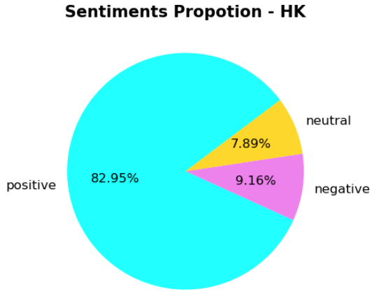
SENTIMENT ANALYSIS –HOME & KITCHEN
1. The sentiment proportion for grocery products is largely composed of positive sentiments, representing around 83% of feedback.
2. Neutral sentiments make up only a small proportion of 7.9% for Home and Kitchen.
3. Negative sentiments also exist, but their proportion is around 9% for Home and Kitchen.
4. Overall, the sentiment analysis indicates that customers are generally happy with their purchases, and positive reviews are the most common.

Slide 7
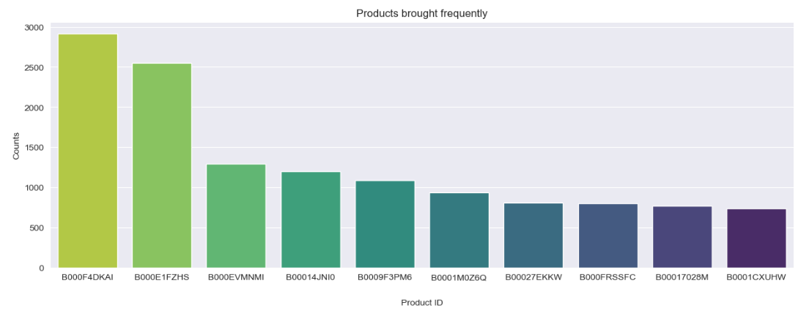
PRODUCTS IN DEMAND - GROCERY
1. According to our analysis, we have identified the top frequently purchased products by customers.
2. The most commonly purchased product over the years is B000F4DKAI, followed by B000E1FZHS and B000VMNMI.

Slide 8
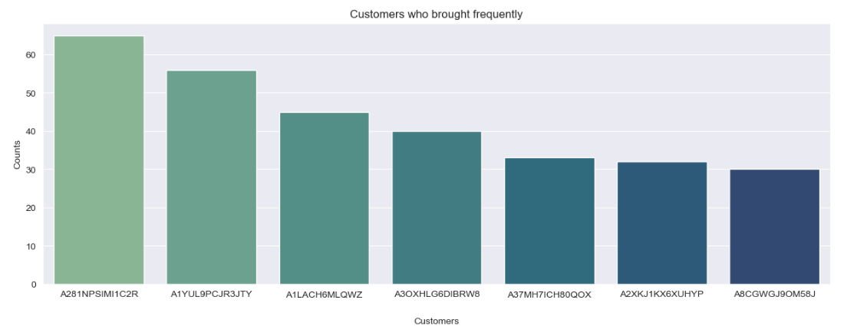
REGULAR CUSTOMERS - GROCERY
1. As we mentioned earlier, these are the customers who have made frequent purchases from us and are considered as our top buyers.
2. Additionally, given their buying behavior, these customers could potentially be valuable advocates for our brand and could engage in word-of-mouth marketing that could generate new business opportunity.

Slide 9
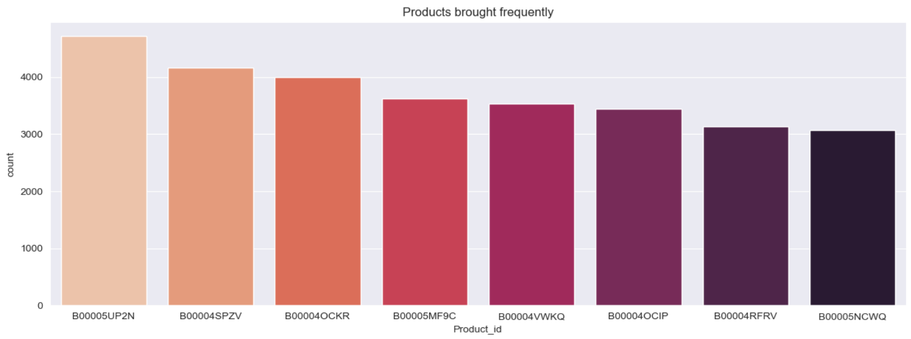
PRODUCTS IN DEMAND - HOME & KITCHEN
1. According to our analysis, we have identified the top frequently purchased products by customers.
2. The most commonly purchased product over the years is B00005UP2N, followed by B00004SPZV and B00004OCKR.

Slide 10
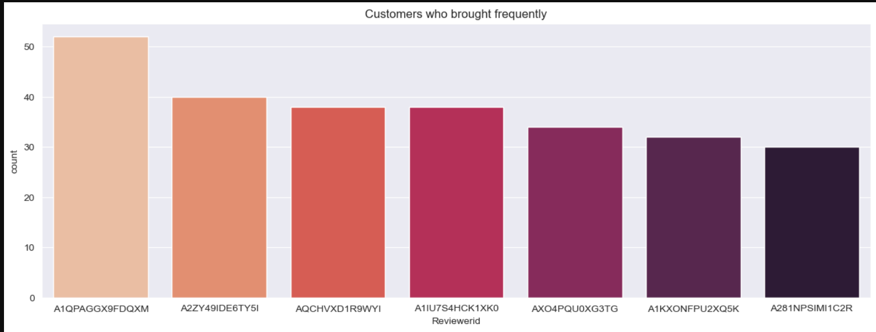
REGULAR CUSTOMERS - HOME & KITCHEN
1. On basis of regularity these are the top most customers.
2. These customers might be interested on trying out new products or they might be interested to buy products of other category as well.

Slide 11
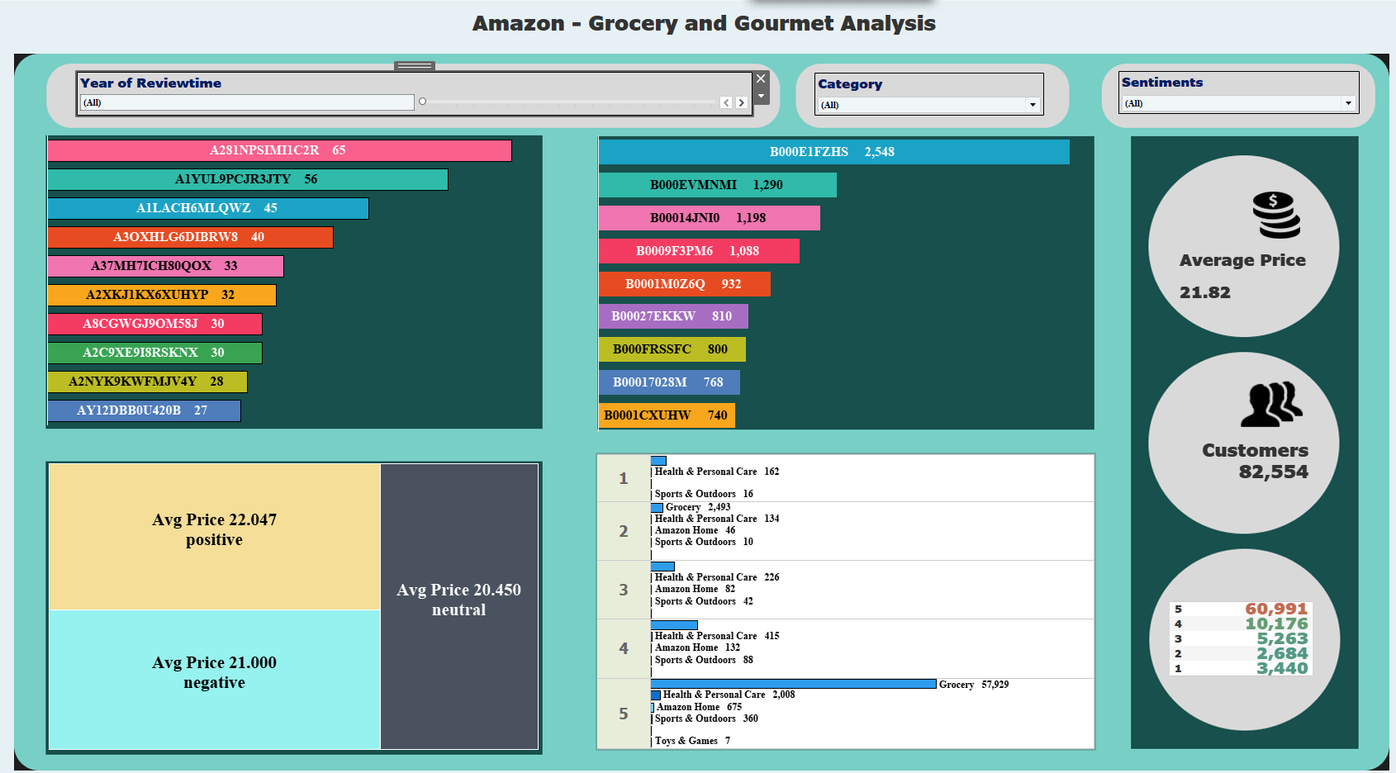

Slide 12
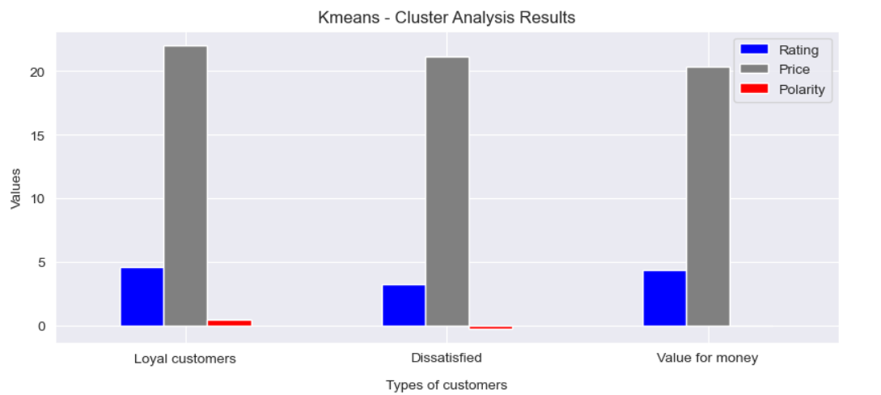
CLUSTER ANALYSIS - GROCERY

Slide 13
CLUSTER ANALYSIS - GROCERY
1. Luxury Shoppers :
Cluster 1 belongs to the customers who are more likely to purchase high-quality and expensive products, as they have the highest average price and rating.
2. Dissatisfied Customers :
Cluster 2 belongs to the customers who are less satisfied with their purchases, as they have the lowest average rating and a high percentage of negative sentiments.
3. Value Shoppers :
Cluster 3 belongs to the customers who are more focused on products with a neutral sentiment, and may be more price-sensitive, as they have the lowest average price.

Slide 14
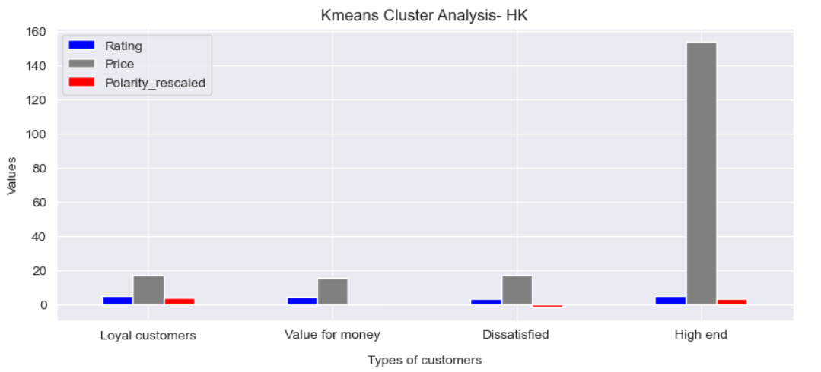
CLUSTER ANALYSIS-HOME & KITCHEN

Slide 15
CLUSTER ANALYSIS – HOME & KITCHEN
1. Loyal Customers :
have highest average rating are highly verified customers. purchase high-priced products and have a positive sentiment in their reviews value quality products and are willing to pay for them.
2. Value For Money Customers :
have an average rating and purchase at a lower price point have a neutral sentiment. prioritize lower-priced products over brand loyalty.
3. Dissatisfied Customers :
have the lowest average rating. purchase at average price point have a negative sentiment who are likely to switch to other brand.
4. High end Customers :
have the highest average price point. a positive sentiment in their reviews. value quality products and are willing to pay a premium price.

Slide 16
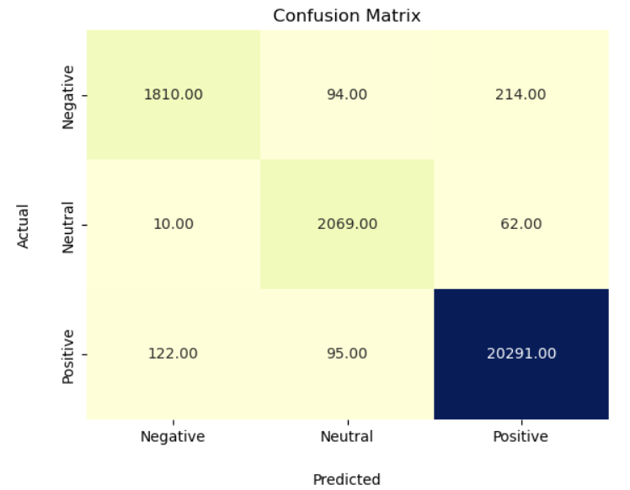
CLASSIFICATION MODEL - GROCERY
1. After evaluating 4 different models, we found that the Logistic Regression outperformed than the others.
2. Reason - It has the high F1 score of 98%, along with the accuracy, precision and recall score of 98%.
3. Confusion matrix also show us there are only few misclassifications done by the model compare to others.
4. The Logistic Regression model is capable of accurately predicting sentiments of customer feedbacks.

Slide 17
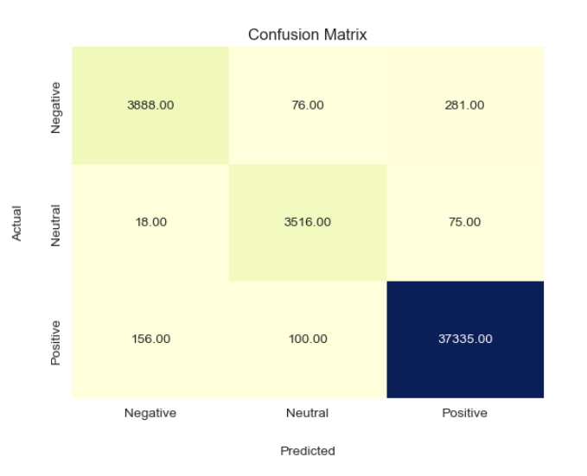
CLASSIFICATION MODEL –HOME & KITCHEN
1. After evaluating 4 different models, we found that the Logistic Regression outperformed than the others.
2. Reason - It has the high F1 score of 98%, along with the accuracy, precision and recall score of 98%.
3. Confusion matrix also show us there are only few misclassifications done by the model compare to others.
4. The Logistic Regression model is capable of accurately predicting sentiments of customer feedbacks.

Slide 18
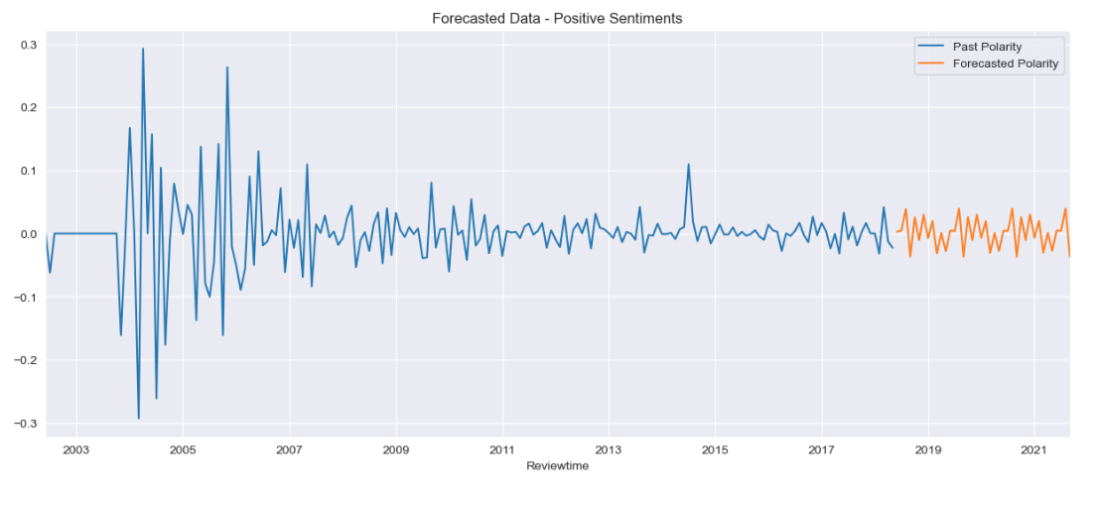
FORECASTING FOR POSITIVE SENTIMENTS- GROCERY
1. This is the forecasted pattern for the next 40 months using SARIMA model.
2. The pattern of positive sentiments appears complex with fluctuations occurring throughout the years. Specifically, there are sudden rises and falls observed over the years.
Positive Sentiments

Slide 19
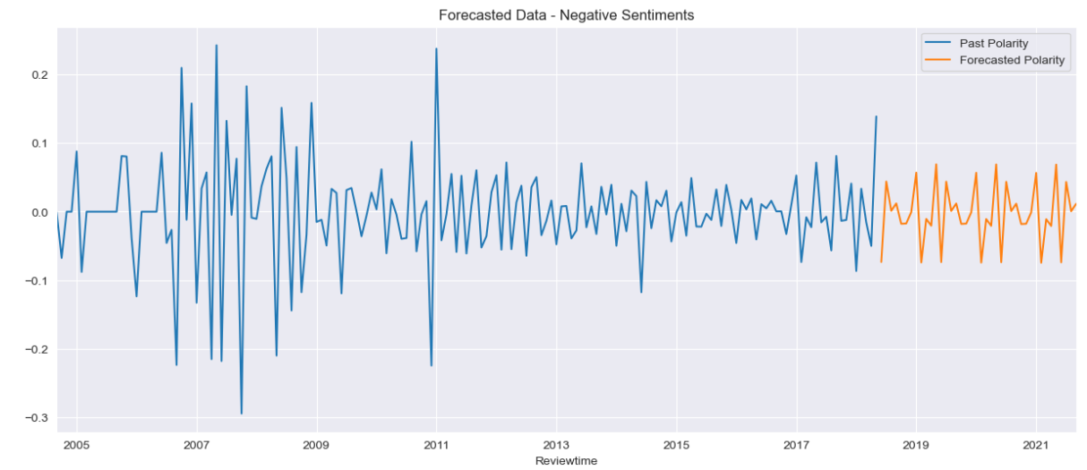
FORECASTING FOR NEGATIVE SENTIMENTS- GROCERY
1. This is the forecasted pattern for the next 40 months using SARIMA model.
2. The observed negative sentiments demonstrate fluctuations over the years, with similar patterns present across all the observed periods.
Negative Sentiments

Slide 20
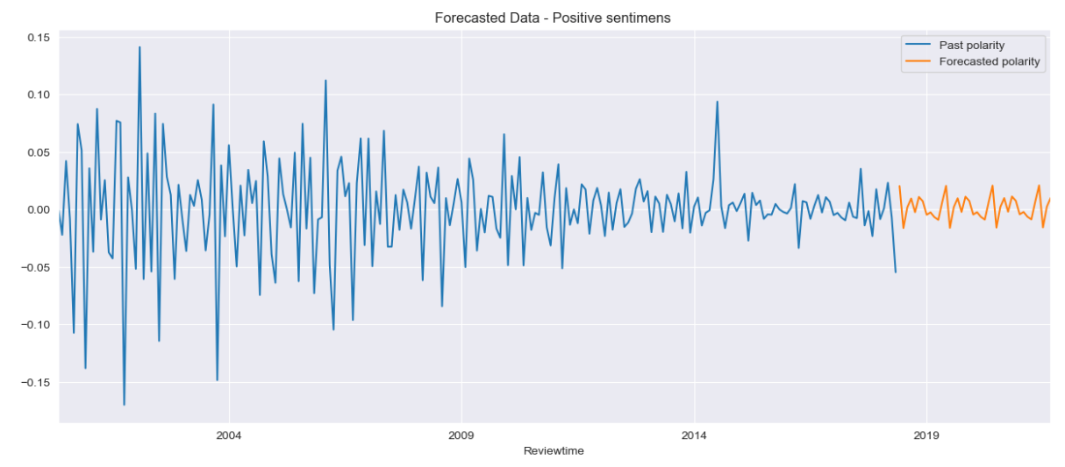
FORECASTING FOR POSITIVE SENTIMENTS– HOME & KITCHEN
1. This is the forecasted pattern for the next 40 months using SARIMA model.
2. Forecasted data suggests that the sentiment in the upcoming year may be less diverse than in previous years.
Positive Sentiments

Slide 21
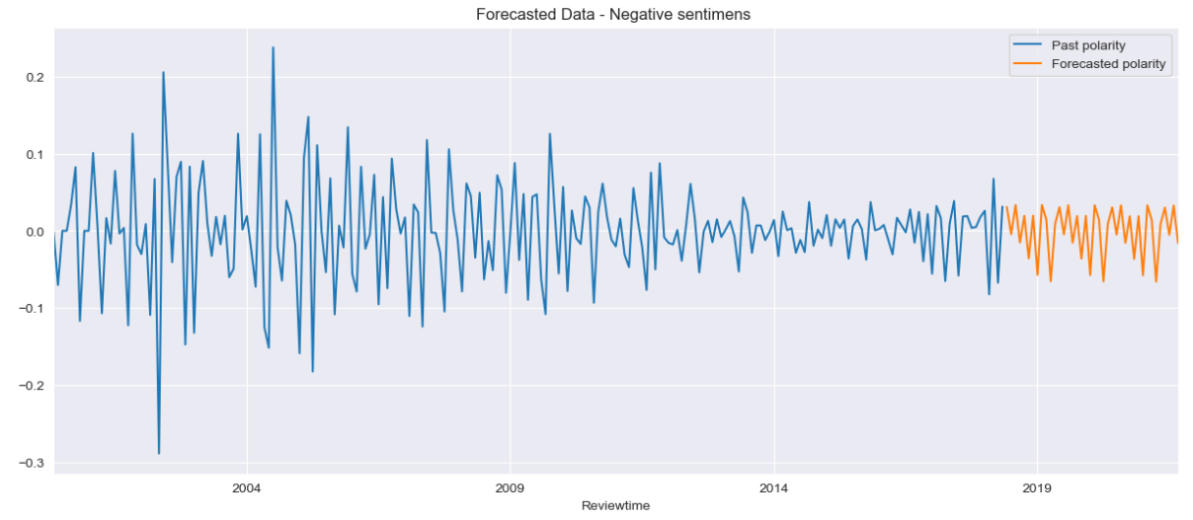
FORECASTING FOR NEGATIVE SENTIMENTS – HOME & KITCHEN
1. This is the forecasted pattern for the next 40 months using SARIMA model..
2. Based on the forecasted data, negative sentiments are expected to display a seasonal pattern in the coming 40 months, followed by a complex pattern of variations that include ups and downs in subsequent years.
Negative Sentiments

Slide 22
CONCLUSIONS
1. In both products, the number of positive sentiments is greater than the number of negative and neutral sentiments.
2. Majority of the customers feels positive about the products.
3. There are 4 types of customer behaviours luxury shoppers, value shoppers, dissatisfied and high end customers.
4. The data shows fluctuations in both positive and negative sentiments towards grocery products, with sudden rises and falls observed over the years .
5. Home and kitchen products show more fluctuations in negative sentiments, with slight higher variations, while positive sentiments experience less fluctuation.
6. Logistic Regression is the best performing model among all that have been evaluated for sentiment classification of text data.

Slide 23
RECOMMENDATIONS
1. Continue to prioritize providing high-quality products and excellent customer service to maintain and increase positive customer sentiments towards the products.
2. Segment customers into different categories based on their behaviour and tailor marketing and promotional efforts accordingly.
3. Offer rewards or discounts to encourage customers to keep buying and to try new products. Promote similar products with deals to encourage repeat purchases.
4. Customers interested in trying out new products, look for rewards or discounts offered .
5. Continuously monitor and analyze sales and customer data to identify trends and patterns in customer behaviour.
6. This can help to make more informed decisions and to better understand which products and promotions are most effective.

Slide 24
Thank you

